Slide 1

DATABUSTERS
FINALS
Group 18 - NutBusters
Xander, Ryan, Bryce, Yi Hong
FORECASTING RECESSIONS

Slide 2

OVERVIEW
Improvements based on feedback received
Q1: Identifying key indicators
Improved forecast
Q2: How policymakers will react
Q3: Considerations due to President Trump

Slide 3
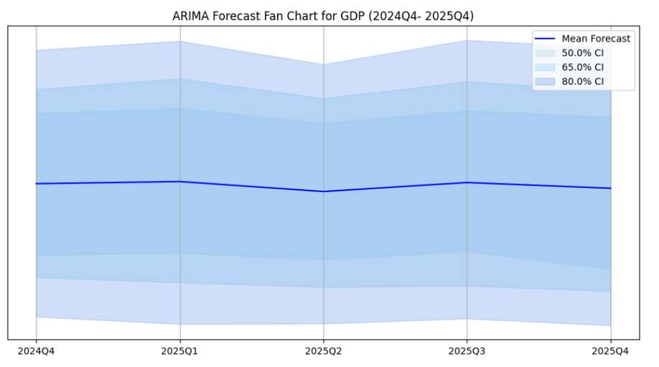
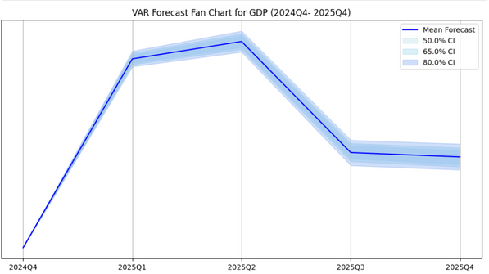


Improvement based on Feedback on Methodology
Did model fitting with AutoRegressive Integrated Moving Average (ARIMA) and Vector autoregression (VAR)
Removed highly correlated variables based on corealtion matrix
ARIMA
VAR
Feature Selection
Model Fitting
Forecast
Removed key economic indicators that are naturally correlated but still carry distinct predictive value.
VAR model not as useful for forecasting recession. Autoregressive Distributed Lag
(ADL) would be better suited
Missing tick marks on y axis
Notes:
"Our initial approach to feature selection was based on statistical correlation. We began by computing a correlation matrix and identifying variables that had a correlation higher than 0.85. The idea was that if two variables are highly correlated, then they would be dropped as they essentially provide the same information, which could lead to overfitting or distortions in the model. After filtering out these high-correlation features, we reintroduced five selected variables .
While our previous methodology helped reduce multicollinearity and overfitting, it also introduced some unintended problems. By strictly removing variables with correlations above 0.85, we overlooked key economic indicators that, while correlated, still carried distinct predictive value.
Certain economic indicators are naturally derived from one another. Industrial Production and Consumption, for example, often have overlapping components. Instead of eliminating one entirely, a better approach would be to analyze which specific aspects of each variable contribute meaningfully to predictions. Otherwise, we risk throwing away useful information."
"In short, relying purely on correlation thresholds led us to remove too many important economic indicators. To improve our approach, we need to incorporate more economic reasoning and utilise our domain knowledge to handpick the variables alongside statistical analysis."

Slide 4

Question 1:
Identify the key predictors of economic downturns and provide economic intuition for the reasons they make good indicators to monitor
Previous methodology:
Correlation matrix used to identify features with correlations > 0.85.
High-correlation features dropped to prevent distorted predictions and overfitting
Next, added back 5 selected variables from the FRED-QD (2010) report
Problem with methodology:
Removed key economic indicators that are naturally correlated but still carry distinct predictive value.
Variables that are composites of each other and thus highly correlated (ie. Industrial Production variables, Consumption variables)
Better to use domain knowledge and handpick variables that vary according to economic downturns
IP:Total index
IP:Final products
IP:Consumer goods
IP:Materials
IP:Dur gds materials
IP:Nondur gds materials
IP:Dur Cons. Goods
IP:Auto
IP:NonDur Cons God
IP:Bus Equip
IP:Energy Prds
Notes:
"Our initial approach to feature selection was based on statistical correlation. We began by computing a correlation matrix and identifying variables that had a correlation higher than 0.85. The idea was that if two variables are highly correlated, then they would be dropped as they essentially provide the same information, which could lead to overfitting or distortions in the model. After filtering out these high-correlation features, we reintroduced five handselected variables .
While our previous methodology helped reduce multicollinearity and overfitting, it also introduced some unintended problems. By strictly removing variables with correlations above 0.85, we overlooked key economic indicators that, while correlated, still carried distinct predictive value.
Certain economic indicators are naturally derived from one another. Industrial Production and Consumption, for example, often have overlapping components. Instead of eliminating one entirely, a better approach would be to analyze which specific aspects of each variable contribute meaningfully to predictions. Otherwise, we risk throwing away useful information."
"In short, relying purely on correlation thresholds led us to remove too many important economic indicators. To improve our approach, we need to incorporate more economic reasoning and utilise our domain knowledge to handpick the variables alongside statistical analysis."

Slide 5

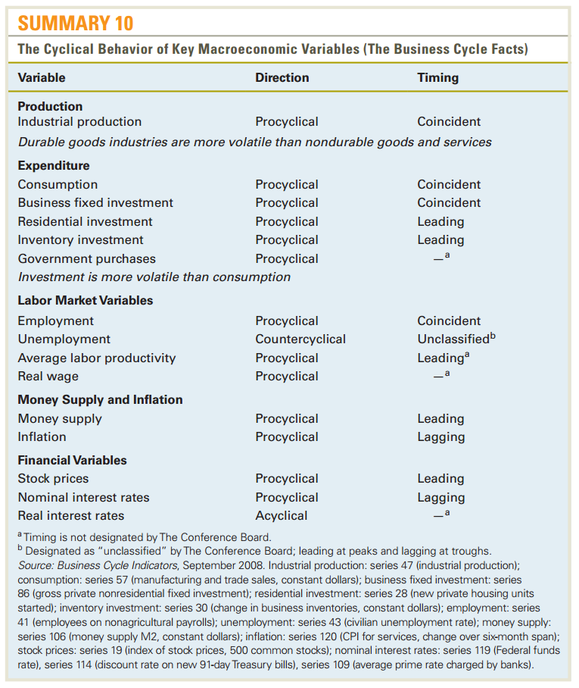
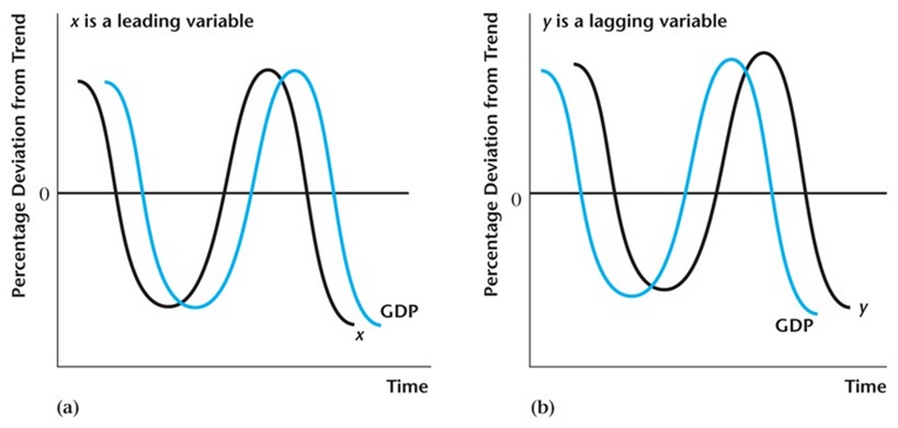
Q1: Identifying key predictors of economic downturns
New methodology:
Using only domain knowledge (from EC2102 and other sources) to handpick variables
Use leading indicators
Lagging indcators like unemployment and inflation will not be so useful
GDP by its composite functions
Y = C + I + G + (X - M)
Source: Macroeconomics (Abel, Bernanke, Croucshore)
-> EC2102 Textbook
Notes:
"To address the limitations of our previous approach, we are shifting to a more informed and selective feature selection process based on economic domain knowledge. Instead of relying solely on correlation thresholds, we will carefully handpick variables using insights from EC2102 and other relevant sources."
"One key improvement is prioritizing leading indicators—variables that change before the economy as a whole begins to shift. These indicators give us early signals of economic trends, making them highly valuable for prediction. In contrast, lagging indicators like unemployment and inflation, while important for economic analysis, tend to react after economic changes have already occurred. As a result, they are less useful for predictive modeling."
"Another important change is focusing on GDP through its composite functions. Instead of using GDP as a single aggregate measure, we will analyze its key components—consumption, investment, government spending, and net exports. This allows us to better capture the underlying drivers of economic activity rather than treating GDP as a black-box variable."
"By incorporating economic reasoning into our feature selection, we ensure that our model reflects real-world economic dynamics more accurately, improving both its predictive power and interpretability."

Slide 6

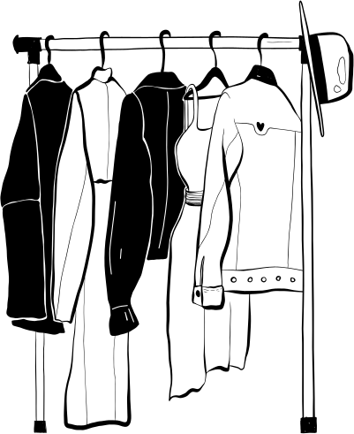


Q1: Identifying key predictors of economic downturns
Y = C + I + G + (X - M)
Consumption
Goods
Services
Durable Goods
Non-Durable Goods
Motor vehicles and parts
Healthcare
Food and beverages purchased for off-premises consumption
Furnishings and durable household equipment
Recreational goods and vehicles
Recreational Services
Housing and Utilities
Gasoline and other energy goods
Clothing and footwear
Notes:
"When analyzing economic downturns, one of the most important components of GDP to examine is consumption. However, total consumption expenditure includes a vast range of spending categories, making it crucial to identify which portions provide the best predictive insights. Instead of using total consumption as a single variable, we would instead break down total consumption expenditure into two broad categories: Goods and Services. Goods are further divided into Durable Goods—items that last over time, like cars and furniture—and Non-Durable Goods, which are consumed quickly, such as gasoline and food. Similarly, Services include essential spending like healthcare and utilities, as well as discretionary spending like recreational services."
"This structured approach allows us to make more precise predictions by focusing on the most responsive segments of consumer spending rather than relying on broad, aggregated measures."

Slide 7
Q1: Identifying key predictors of economic downturns
Identified as indicators of downturns
Desired Consumption (Will vary based on income/ consumer outlook)
Y = C + I + G + (X - M)
Consumption
Autonomous Consumption (Essentials, will not vary even in downturns)
Goods
Services
Durable Goods
Non-Durable Goods
Motor vehicles and parts
Healthcare
Food and beverages purchased for off-premises consumption
Furnishings and durable household equipment
Recreational goods and vehicles
Recreational Services
Housing and Utilities
Gasoline and other energy goods
Clothing and footwear
Notes:
"Not all consumption categories react to economic downturns in the same way. Some spending areas decline sharply, making them strong early indicators of economic trouble, while others remain stable, making them weaker predictors. By distinguishing between these, we can focus on the most relevant variables for our model."
"Durable goods, such as cars, appliances, and furniture, require significant financial commitment. During periods of economic uncertainty, consumers tend to delay or cancel these purchases first, making this a strong leading indicator. Specifically, spending on recreational goods and vehicles is highly discretionary, meaning it drops quickly when consumer confidence weakens."
"Similarly, spending on recreational activities, dining out, and travel declines during downturns. These services are not essential, so households cut back on them as they adjust their budgets. A slowdown in these sectors is often an early sign of reduced consumer spending power and economic distress."
"On the other hand, spending on essential services such as housing, utilities, and healthcare is relatively inelastic. Regardless of economic conditions, people still need to pay rent, electricity bills, and medical expenses. Because these expenditures remain stable even during downturns, they are weak predictors of economic slowdowns."
"By focusing on strong indicators like durable goods and discretionary services, we can better detect early signs of economic downturns and improve the predictive accuracy of our model."

Slide 8
Q1: Identifying key predictors of economic downturns
Y = C + I + G + (X - M)
University of Michigan Consumer Sentiment Index can signal future consumption trends.
Consumer spending accounts for ~70% of GDP
When sentiment drops, households cut back on discretionary spending, leading to slower economic growth.
The “buying conditions for durable goods” component is especially predictive, as consumers delay big-ticket purchases during uncertainty.
Variable Name | FRED MNEMONIC
University of Michigan Consumer Sentiment Index | UMCSENTx
PCE: Recreational goods and vehicles | DREQRG3Q086SBEA
PCE: Clothing and footwear | DCLORG3Q086SBEA
PCE: Recreational Services | DRCARG3Q086SBEA
Notes:
"Consumer spending makes up approximately 70% of GDP, making it a crucial driver of economic growth. One of the best ways to anticipate changes in spending behavior is through the University of Michigan Consumer Sentiment Index, which measures how confident households feel about their financial situation and the broader economy."
"When consumer sentiment drops, it often signals that households are becoming more cautious. As a result, they cut back on discretionary spending—particularly on non-essential goods and services like dining out, travel, and entertainment. This reduction in spending slows overall economic growth, making consumer sentiment a valuable leading indicator."
"One of the most predictive components is the ‘Buying Conditions for Durable Goods’ measure. Durable goods, such as cars, appliances, and furniture, require significant financial commitment. During periods of uncertainty, consumers often delay these big-ticket purchases, causing a noticeable drop in demand. Since durable goods spending is highly sensitive to economic conditions, tracking consumer sentiment in this area provides an early warning sign of potential downturns."
"By incorporating consumer sentiment data, we can enhance our ability to forecast shifts in consumption trends and economic activity."

Slide 9

Q1: Identifying key predictors of economic downturns
Y = C + I + G + (X - M)
Investment
Real Gross Private Domestic Investment
Reflects overall investor confidence in future growth
Real private fixed investment: Residential
Housing market is highly sensitive to shifts in interest rates, consumer confidence, and income expectations
Industrial Production: Business Equipment
When businesses expect robust demand, they invest in machinery and equipment to boost capacity
Conversely, when outlooks darken, firms scale back production plans
Variable Name | FRED MNEMONIC
Real Gross Private Domestic Investment | GPDIC1
Industrial Production: Business Equipment | IPBUSEQ
Real private fixed investment: Residential | PRFIx
Notes:
The next component of GDP is investment.
, Real Gross Private Domestic Investment is another critical driver of economic activity. It reflects overall investor confidence in future growth, making it a strong predictor of economic downturns."
"a second key component is Real Private Fixed Investment – Residential, which represents spending on housing. The housing market is particularly sensitive to shifts in interest rates, consumer confidence, and income expectations. When confidence is high and borrowing costs are low, home purchases increase, driving economic growth. However, when uncertainty rises, potential buyers delay purchases, leading to a slowdown in residential investment."
"Another important factor is Industrial Production – Business Equipment. Businesses invest in machinery and equipment when they anticipate strong future demand, expanding capacity to meet growth expectations. However, when economic outlooks darken, firms often scale back production plans, reducing investment in new equipment. A decline in business equipment spending is a clear warning sign of slowing economic activity."

Slide 10
Q1: Identifying key predictors of economic downturns
Y = C + I + G + (X - M)
Government Expenditure
Assumed to be autonomous
US Treasury department can stimulate the economy through fiscal policies by incuring debt
Excluded from our selected variables
Variable Name | FRED MNEMONIC
Real Exports of Goods & Services | EXPGSC1
Real Imports of Goods & Services | IMPGSC1
Exports - Imports
Falling exports indicate weakening global demand
Imports are closely tied to consumer spending and business investment
Notes:
"While consumer spending and private investment drive much of the economy, government expenditure and net exports also play key roles in shaping economic trends."
"Government spending is generally assumed to be autonomous, meaning it does not fluctuate directly with the business cycle in the same way that private consumption or investment does. However, the U.S. Treasury Department can actively stimulate the economy through fiscal policies, such as increased infrastructure spending or stimulus programs. As such, we have left out government consumption spending and government investment expenditure from our selected variables
"Another important factor is net exports (Exports – Imports). A decline in exports signals weakening global demand, which can be an early sign of slowing economic activity both domestically and internationally. On the other hand, imports are closely linked to consumer spending and business investment. When the economy is strong, businesses and households import more goods and services. However, when spending slows, imports decline as well, reflecting reduced economic activity."

Slide 11


Q1: Identifying key predictors of economic downturns
Representing | Variable Name | FRED MNEMONIC | Horizon Timeline
Consumption | University of Michigan Consumer Sentiment Index | UMCSENTx | Short-Term
Consumption | PCE: Recreational goods and vehicles | DREQRG3Q086SBEA | Short-Term
Consumption | PCE: Clothing and footwear | DCLORG3Q086SBEA | Short-Term
Consumption | PCE: Recreational Services | DRCARG3Q086SBEA | Short-Term
Investment | Real Gross Private Domestic Investment | GPDIC1 | Medium-Term
Investment | Industrial Production: Business Equipment | IPBUSEQ | Medium-Term
Investment | Real private fixed investment: Residential | PRFIx | Medium-Term
Money Supply | Real M2 Money Stock | M2REAL | Medium-Term
Stock Market | S&P's Common Stock Price Index: Composite | S&P 500 | Short-Term
Short-Term (0-6 months)
Medium Term (6-12 months)
Notes:
These are the key predictors of economic downturn that we have identified. New to this list is
M2
When the Federal Reserve increases M2 (e.g., by lowering rates), it encourages borrowing and spending—often boosting the economy before growth is visible.
Consumer & Business Behavior:
Higher M2 means more money in checking/savings accounts and money market funds, increasing spending and investment capacity.
A slowdown in M2 growth can signal tightening liquidity, leading to reduced spending and a potential economic slowdown.
s&P
Stock prices are based on anticipated corporate earnings, which depend on future economic conditions.
Investors adjust stock prices in response to expected changes in GDP growth, interest rates, and consumer demand.

Slide 12
Q1: Identifying key predictors of economic downturns
Representing | Variable Name | FRED MNEMONIC | Horizon Timeline
Industrial Production | Industrial Production: Durable Consumer Goods | IPDCONGD | Medium-Term
Employment | All Employees: Durable goods | DMANEMP | Medium-Term
Exports | Real Exports of Goods & Services | EXPGSC1 | Medium-Term
Imports | Real Imports of Goods & Services | IMPGSC1 | Medium-Term
Short-Term (0-6 months)
Medium Term (6-12 months)
Notes:
M2
When the Federal Reserve increases M2 (e.g., by lowering rates), it encourages borrowing and spending—often boosting the economy before growth is visible.
Consumer & Business Behavior:
Higher M2 means more money in checking/savings accounts and money market funds, increasing spending and investment capacity.
A slowdown in M2 growth can signal tightening liquidity, leading to reduced spending and a potential economic slowdown.
s&P
Stock prices are based on anticipated corporate earnings, which depend on future economic conditions.
Investors adjust stock prices in response to expected changes in GDP growth, interest rates, and consumer demand.

Slide 13
Improvement based on Feedback on Methodology
Did model fitting with AutoRegressive Integrated Moving Average (ARIMA) and Vector autoregression (VAR)
Removed highly correlated variables based on corealtion matrix
ARIMA
VAR
Feature Selection
Model Fitting
Forecast
Removed key economic indicators that are naturally correlated but still carry distinct predictive value.
VAR model not as useful for forecasting recession. Autoregressive Distributed Lag
(ADL) would be better suited
Missing tick marks on y axis
Notes:
instead of using ARIMA and VAR, we used ARIMA and ADL

Slide 14
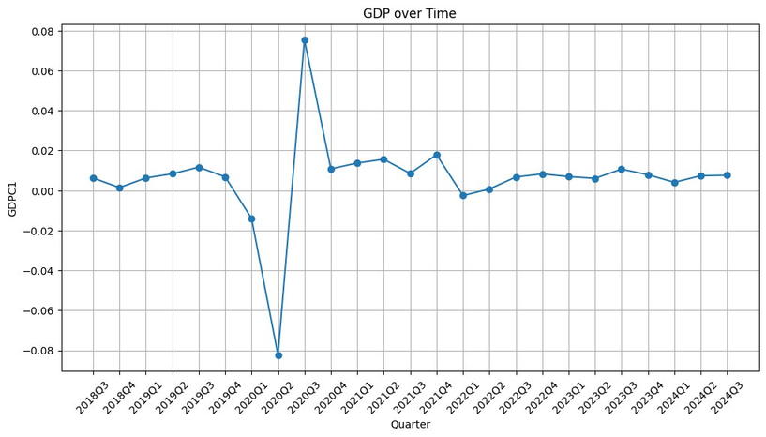
Working on Feedback on ARIMA Model
Parameter | Value
Number of lag observations | 2
Number of times the raw observations are differenced | 0
Size of the moving average window | 2
Feedback: Coefficients likely biased due to Covid-19 outliers (sharp drop and sharp increase in growth rates)
Adjustment: Removed observations from 2020Q1 onwards, then tried forecasting 2020-2021
+7.8%
-7.9%
End result:
Still a flat graph
Feedback: Previously used parameters 5,2,5 -> over-differencing kills any predictability from the model, leading to a flat prediction
Adjustment: Changed parameters based on lowest AIC

Slide 15
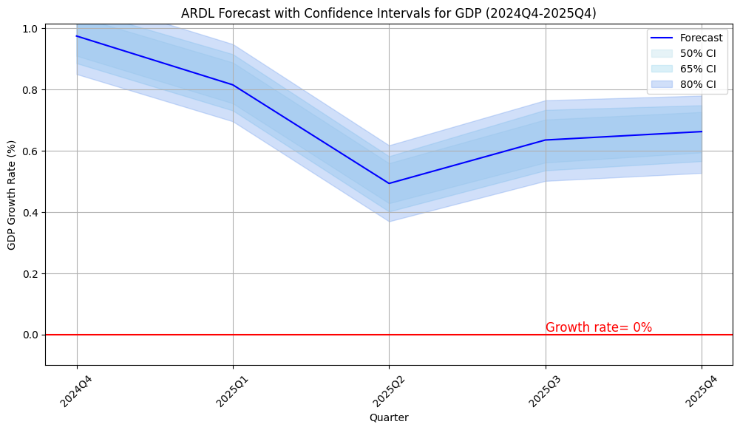
Improved forecast of GDP growth rate using the ARDL model
Parameters
Parameter | Explanation | Value
Maxorder | maximum number of lags to be used by the model on dependent variable | 1
Maxlag | maximum number of lags to be used by the model on every independent variable | 5

Slide 16


Q2. How would you expect policymakers in Singapore to act based on your forecasts and what are the associated risks they might face?
Monetary Policy
In view of a slowing US economy and hence weakened external demand for Singapore’s exports, the Monetary Authory of Singapore (MAS) can allow for modest depreciation of SGD, to enhance Singapore’s export competitiveness.
Risks
However, using expansionary monetary policy (i.e. managed float) may lead to inflationary pressure, especially if global supply chain disruptions persist (e.g. Russia-Ukraine war).
Increased exchange rate volatility may potentially deter foreign investment.

Slide 17
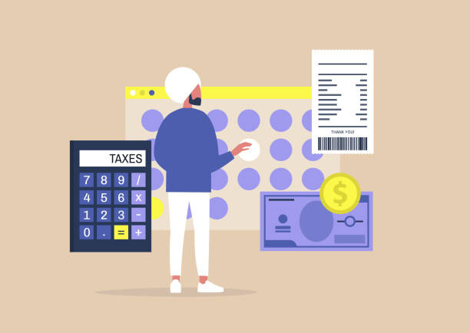
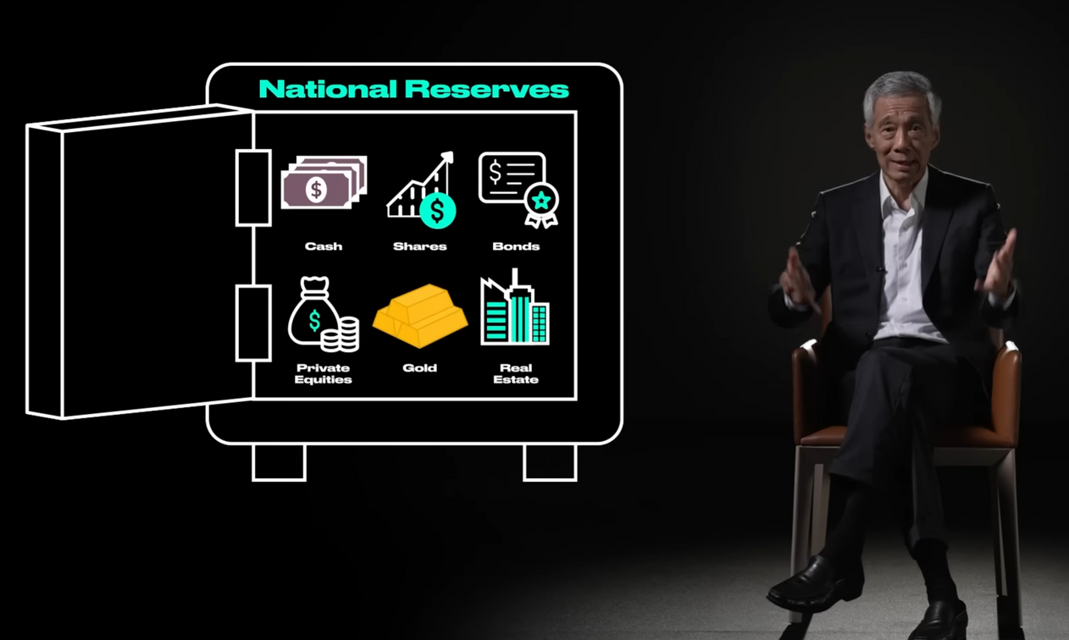
Q2. How would you expect policymakers in Singapore to act based on your forecasts and what are the associated risks they might face?
Fiscal Policy
The government may also consider fiscal measures such as tax rebates for businesses, infrastructure spending, or direct support for affected industries like manufacturing and logistics.
To offset weak external demand, the government might implement measures to boost domestic consumption, such as cash transfers and wage subsidies.
Risks
Fiscal stimulus may require the use of Singapore’s national reserves, limiting Singapore’s ability to respond to future crises.

Slide 18


Q2. How would you expect policymakers in Singapore to act based on your forecasts and what are the associated risks they might face?
Fiscal Policy
Another important consideration is enhancing long-term economic resilience.
The Ministry of Trade and Industry (MTI) may also consider diversifying trade partnerships, to reduce reliance on the US economy.
For example, during the COVID-19 pandemic, Singapore began importing eggs from Poland and Ukraine, and seafood from countries like Norway and Ecuador.

Slide 19

While our models suggest a challenging global environment in 2025...
policymakers are able to make more informed decisions by leveraging data-driven insights to guide policymaking.

Slide 20



Q3. Considering the proposed tariffs and other plans likely to be enacted in 2025 by the newly elected U.S. President Trump, what judgmental adjustments might you make to your forecasts based on this qualitative information not yet reflected in the data?
Imposing tariffs
introduced substantial tariffs on imports,
25% tariff on goods from Canada and Mexico
10% tariff on products from China.
These measures aim to protect domestic industries but have led to increased production costs and disrupted supply chain
Effect
International Monetary Fund (IMF) estimates that such tariffs could reduce U.S. GDP growth by approximately 1 percentage point in 2025 and 2026.

Slide 21


Q3. Considering the proposed tariffs and other plans likely to be enacted in 2025 by the newly elected U.S. President Trump, what judgmental adjustments might you make to your forecasts based on this qualitative information not yet reflected in the data?
Extension of Tax Cuts
efforts are underway to make permanent the individual tax cuts from the 2017 Tax Cuts and Jobs Act, which are set to expire at the end of 2025.
Effect
Short run: may boost consumer spending and short-term economic growth
Long run: projected to increase the federal deficit by $5.8 trillion over the next decade, potentially leading to long-term economic challenges

Slide 22



Q3. Considering the proposed tariffs and other plans likely to be enacted in 2025 by the newly elected U.S. President Trump, what judgmental adjustments might you make to your forecasts based on this qualitative information not yet reflected in the data?
Deregulation Initiatives
Deregulation across various sectors, aiming to reduce compliance costs for businesses
Effect
Short run: may encourage investment and economic activity , it has also introduced policy uncertainty.
Long run: Businesses are cautious about long-term investments due to the unpredictable regulatory environment, which could dampen economic growth prospects

Slide 23


